Slide 1
Image classification with CNN
TriNet Vision Team
1- Rawan Alnajim
2- Nora Alshahrani
3- Albandari Altalhi

Slide 2
Table of Contents
1
Project Overview
6
Conclusion and Insights
2
Data Wrangling and Cleaning
3
Exploratory Data Analysis
4
Teamwork & Project Management
5
Major Obstacle

Slide 3
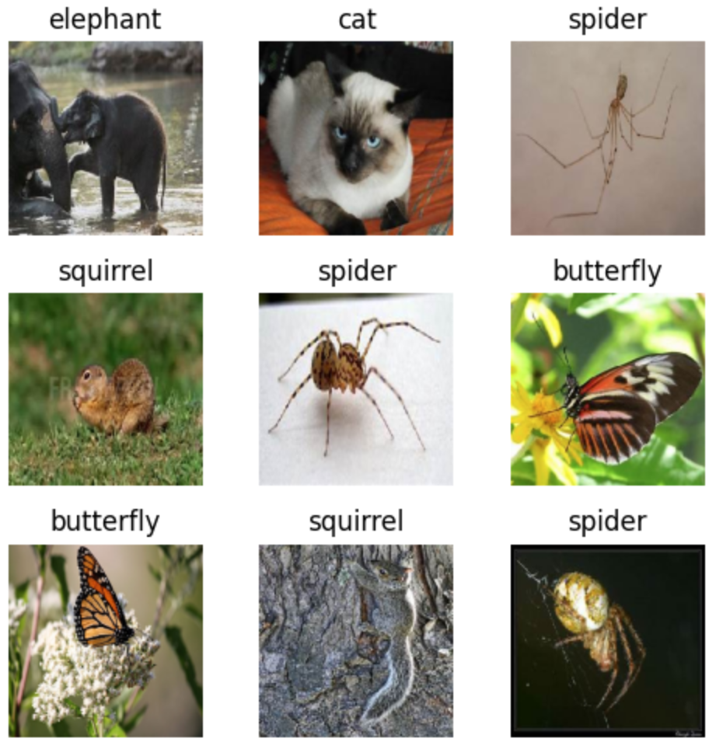
Project Overview
Dataset: Animals 10 – a dataset containing images of 10 different animal classes.
Goal: is to build a baseline CNN model for animal classification and then compare its performance with various transfer learning models (like ResNet152V2, VGG16, etc.) to see how accuracy improves.

Slide 4
Data Wrangling and Cleaning
Split the Animals 10 dataset into 80% training and 20% validation
Applied normalization to images.
Images were resized to 224x224 pixels to match the input size of the CNN model.
The class name is translated from Italian to English for better readability.

Slide 5
Exploratory Data Analysis
Applied Code to calculated the number of samples per class in the training dataset by analyzing the class labels. This revealed the distribution of images across the 10 animal classes. To assess whether the dataset is balanced, or not.

Slide 6
Teamwork & Project Management
Initially, our focus was on building a CNN baseline model. However, after extensive training and experimentation, we realized that further improvements to this model were unlikely to yield significant gains. As a team, we decided to take a different approach, each team member would explore various models to find the most effective solution. Through this collaborative effort, we identified that the ResNet152V2 model provided the best performance, leading us to focus on fine-tuning it for optimal results.

Slide 7
Major Obstacle
Initially, we observed that the validation accuracy was higher than the training accuracy, which can indicate potential issues like data leakage or incorrect data splits. To address this, we ensured that the training and validation datasets were properly separated into different directories. However, the problem persisted, and upon further investigation, we recognized that aggressive data augmentation applied to the training set may have caused this discrepancy. The excessive augmentation likely led to an overfitting of the validation data, which caused the validation accuracy to outperform the training accuracy.

Slide 8
Conclusion and Insights
Our initial hypothesis, which was to build a baseline CNN model and then experiment with transfer learning to improve accuracy, was supported.
The ResNet50V2 model outperformed the baseline CNN model, confirming that transfer learning significantly boosted performance in this case.

Slide 9
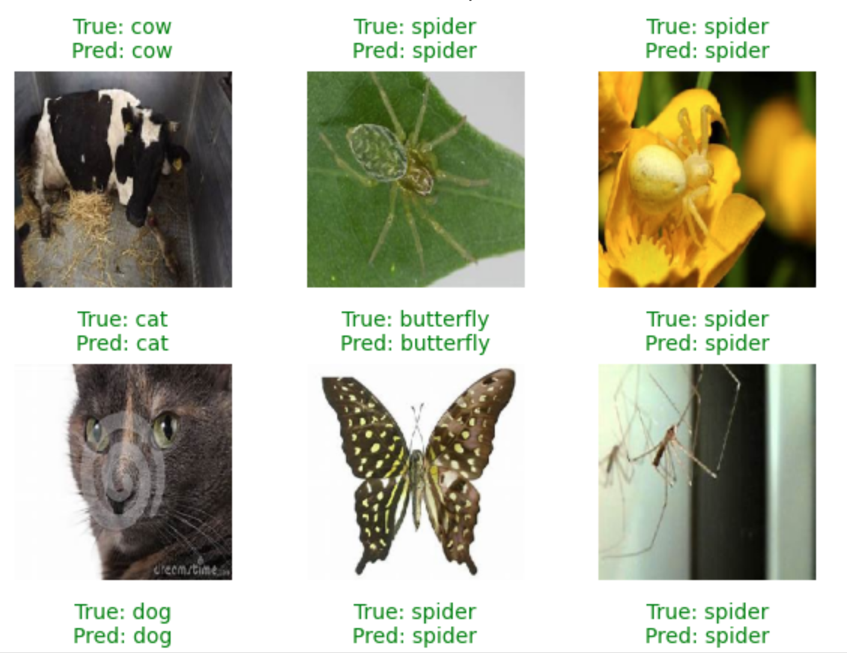
Conclusion and Insights
Challenges:
We faced challenges such as aggressive data augmentation, which led to discrepancies between training and validation accuracy.

Slide 10
Thank you

